Slide 1
Managerial economics
News analysis
NAME : Melwin Shajan
Batch : Bill Gates

Slide 2

News Analysis on Customs Duty from Union Budget 2024-25

Slide 3
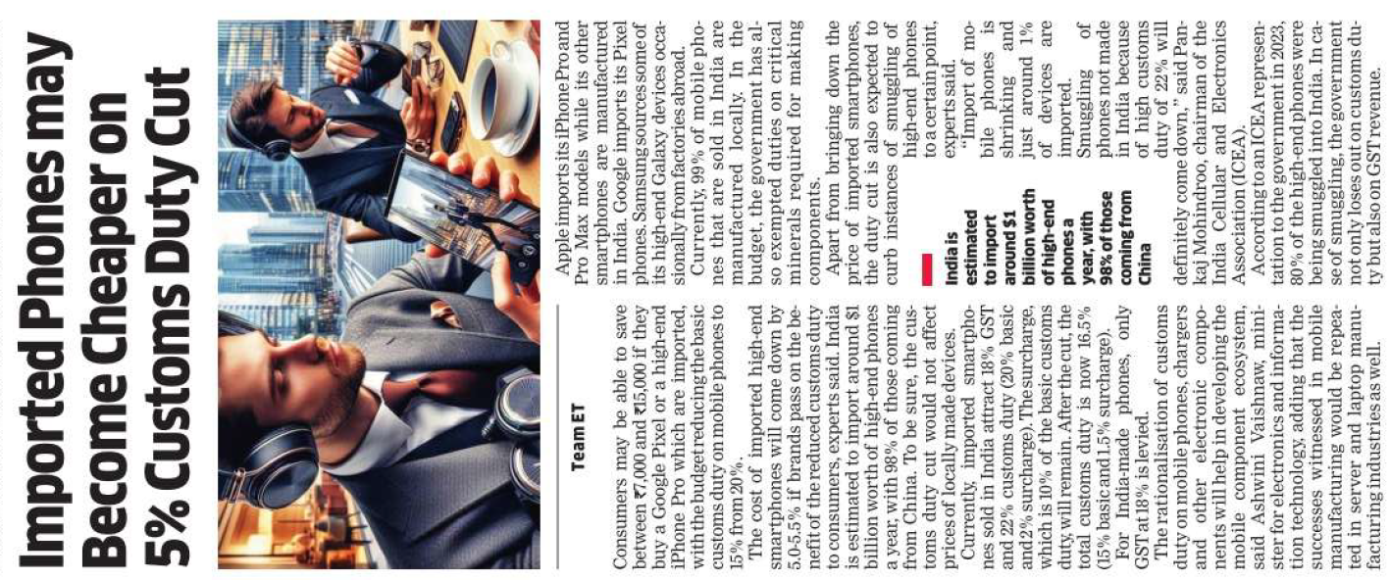
The Economic Times
India reduced basic customs duty on imported mobile phones from 20% to 15%, potentially reducing prices of high-end models like Google Pixel and iPhone Pro by 5.0-5.5%.
Consumers could save ₹7,000 to ₹15,000 on these imported smartphones if brands pass on the duty cut benefits.
Currently, imported smartphones in India are subject to 18% GST and 22% customs duty (20% basic + 2% surcharge), now reduced to 16.5% (15% basic + 1.5% surcharge) after the cut.
Local manufacturing dominates, with 99% of phones sold in India made locally and taxed at 18% GST only.
The duty reduction aims to curb smuggling of high-end phones and promote development in the mobile component ecosystem.

Slide 4
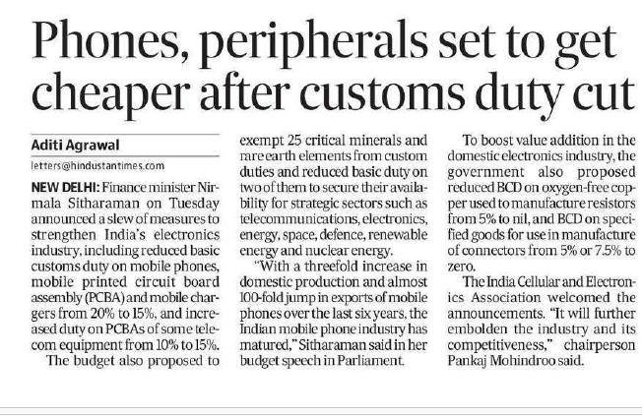
Hindustan Times
Customs Duty Reduction: Basic customs duty on mobile phones, printed circuit board assemblies (PCBA), and mobile chargers reduced from 20% to 15%. The duty on PCBA for telecom equipment increased from 10% to 15%.
Exemptions and Reductions: 25 critical minerals and rare earth elements will be exempt from customs duties or have reduced basic duties to support strategic sectors.
Domestic Production and Exports: The Indian mobile phone industry has seen significant growth in domestic production and exports, with a focus on further development.
Sectoral Innovations: The government also plans to advance digital public infrastructure (DPI) in various sectors, including agriculture, education, and health, with a focus on productivity and innovation.

Slide 5
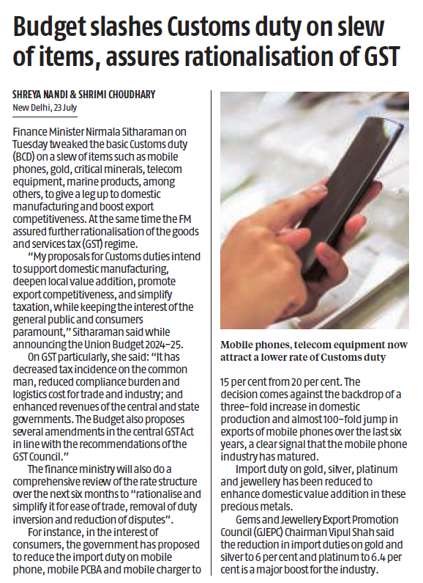
Business Standard
Customs Duty Reduction: Basic customs duties on items like mobile phones, gold, critical minerals, telecom equipment, and marine products have been reduced to support domestic manufacturing and export competitiveness.
GST Rationalization: Finance Minister Sitharaman assured further simplification of the GST regime to decrease tax incidence, ease compliance, and reduce logistics costs.
Comprehensive Review: The finance ministry will review GST rate structures over the next six months to simplify them, address duty inversion, and reduce disputes.

Slide 6
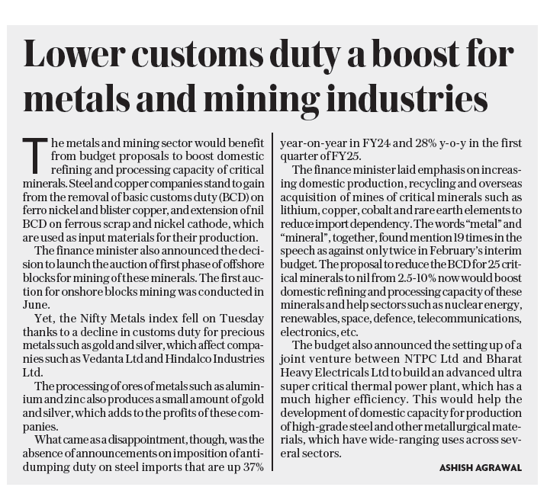
Customs Duty Reduction: The budget removes basic customs duty on ferro nickel and blister copper and extends nil customs duty on ferrous scrap and nickel cathode, benefiting steel and copper industries.
Impact on Metals Sector: Despite these benefits, the Nifty Metals index fell due to reduced customs duties on precious metals like gold and silver, which negatively impact companies like Vedanta Ltd and Hindalco Industries Ltd.
Focus on Critical Minerals: The budget aims to enhance domestic production and processing of critical minerals, including lithium and cobalt, and reduce import dependency.
Joint Venture: A joint venture between NTPC Ltd and Bharat Heavy Electricals Ltd will be established to build an advanced power plant, aiding the development of high-grade steel and other metallurgical materials.
Mint

Slide 7
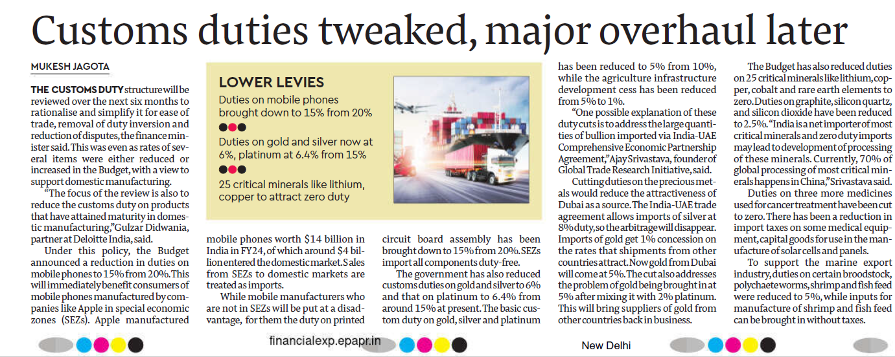
Financial Express
Customs Duty Review: A comprehensive review of customs duties will be conducted over the next six months to simplify and rationalize the system, aiming to ease trade, remove duty inversion, and reduce disputes.
Duty Reductions: The budget reduces customs duties on mobile phones from 20% to 15%, and on printed circuit board assemblies from 20% to 15%. Duties on 25 critical minerals, including lithium and cobalt, have been cut to zero.
Support for Mining and Manufacturing: Zero duties on critical minerals are expected to encourage domestic processing. Duties on medical equipment and cancer treatment medicines have also been reduced.

Slide 8
Summary
Customs Duty Reduction: Basic customs duty on imported mobile phones cut from 20% to 15%.
Price Impact: Potential savings of ₹7,000 to ₹15,000 on high-end smartphones like Google Pixel and iPhone Pro.
Total Duty: New total customs duty is 16.5% (15% basic + 1.5% surcharge).
Effect on Local Devices: No impact on prices of domestically manufactured phones.
Industry Impact: Expected to lower costs of imported phones and reduce smuggling.
Other Budget Measures:
Duty reductions on critical minerals and electronic components.
Efforts to boost domestic electronics manufacturing and processing.
Customs Duty Review: Further rationalization of customs duty and GST structure planned

Slide 9
THANK YOU

